Slide 1
National Cipher Challenge
A beginner’s guide to codes and ciphers
Part 2, frequency analysis

Slide 2
How can you break a cipher when you can’t see the words?
ACMBW VQCAB PMJQW OZIXP MZWNB PMKIM AIZAL MAKZQ JMARC TQCAK IMAIZ ACAMW NIKQX PMZQV PQATM BBMZA BWBPM WZIBW ZKQKM ZWEQB PEPWU PMEIA XTIVV QVOIV LXTWB BQVOQ VBPML GQVOL IGAWN BPMZW UIVZM XCJTQ KQNPM KIMAI ZPILI VGBPQ VOKWV NQLMV BQITB WAIGP MEZWB MQBQV KQXPM ZBPIB QAJGA WKPIV OQVOB PMWZL MZWNB PMTMB BMZAW NBPMI TXPIJ MBBPI BVWBI EWZLK WCTLJ MUILM WCBQN IVGWV MEQAP MABWL MKQXP MZBPM AMIVL OMBIB BPMQZ UMIVQ VOPMU CABAC JABQB CBMBP MNWCZ BPTMB BMZWN BPMIT XPIJM BVIUM TGLNW ZIIVL AWEQB PBPMW BPMZA QVWBP MZEWZ LAKIM AIZCA MLITM BBMZJ GTMBB MZBZI VATIB QWVBW MVKZG XBPQA UMAAI OMA

Slide 3
Any fool knows that to defeat Caesar you use “brute force”
Et tu, Brutus?

Slide 4
If you have enough time/money/people/computers you can try ALL the ciphers. For people this is called team work. For computers it is called parallel processing.

Slide 5
It would take a long time to do this on your own, but with team work you can speed it up
Large teams, working together at Bletchley Park shortened the war by at least two years.

Slide 6
A much smarter way to do it, is to look for patterns
ACMBW VQCAB PMJQW OZIXP MZWNB PMKIM AIZAL MAKZQ JMARC TQCAK IMAIZ ACAMW NIKQX PMZQV PQATM BBMZA BWBPM WZIBW ZKQKM ZWEQB PEPWU PMEIA XTIVV QVOIV LXTWB BQVOQ VBPML GQVOL IGAWN BPMZW UIVZM XCJTQ KQNPM KIMAI ZPILI VGBPQ VOKWV NQLMV BQITB WAIGP MEZWB MQBQV KQXPM ZBPIB QAJGA WKPIV OQVOB PMWZL MZWNB PMTMB BMZAW NBPMI TXPIJ MBBPI BVWBI EWZLK WCTLJ MUILM WCBQN IVGWV MEQAP MABWL MKQXP MZBPM AMIVL OMBIB BPMQZ UMIVQ VOPMU CABAC JABQB CBMBP MNWCZ BPTMB BMZWN BPMIT XPIJM BVIUM TGLNW ZIIVL AWEQB PBPMW BPMZA QVWBP MZEWZ LAKIM AIZCA MLITM BBMZJ GTMBB MZBZI VATIB QWVBW MVKZG XBPQA UMAAI OMA

Slide 7
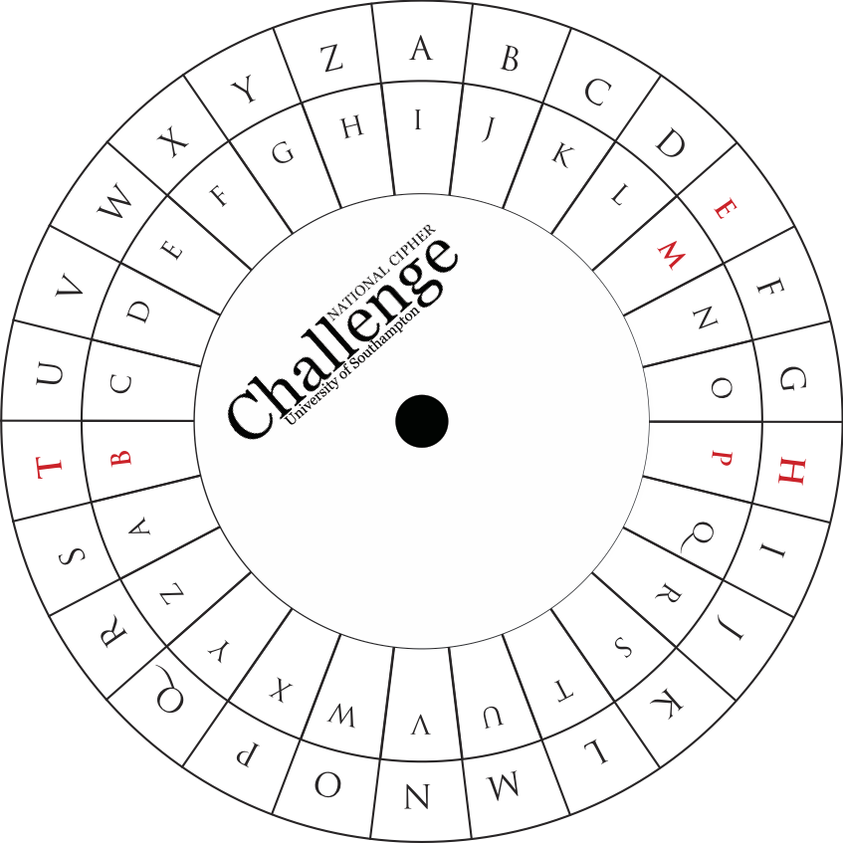
Lining up the cipher wheel so that T matches with B we see H matching with P and E with M. A matches to I so we guess that the cipher we need is a shift by 8.
(We need to be careful to match the plain text on the outer ring with the ciphertext on the inner ring.)
You can now use the cipher wheel to decrypt the rest of the message.

Slide 8
ACMBW VQCAB PMJQW OZIXP MZWNB PMKIM AIZAL MAKZQ JMARC TQCAK IMAIZ ACAMW NIKQX PMZQV PQATM BBMZA BWBPM WZIBW ZKQKM ZWEQB PEPWU PMEIA XTIVV QVOIV LXTWB BQVOQ VBPML GQVOL IGAWN BPMZW UIVZM XCJTQ KQNPM KIMAI ZPILI VGBPQ VOKWV NQLMV BQITB WAIGP MEZWB MQBQV KQXPM ZBPIB QAJGA WKPIV OQVOB PMWZL MZWNB PMTMB BMZAW NBPMI TXPIJ MBBPI BVWBI EWZLK WCTLJ MUILM WCBQN IVGWV MEQAP MABWL MKQXP MZBPM AMIVL OMBIB BPMQZ UMIVQ VOPMU CABAC JABQB CBMBP MNWCZ BPTMB BMZWN BPMIT XPIJM BVIUM TGLNW ZIIVL AWEQB PBPMW BPMZA QVWBP MZEWZ LAKIM AIZCA MLITM BBMZJ GTMBB MZBZI VATIB QWVBW MVKZG XBPQA UMAAI OMA

Slide 9
ACMBW VQCAB PMJQW OZIXP MZWNB PMKIM AIZAL MAKZQ JMARC TQCAK IMAIZ ACAMW NIKQX PMZQV PQATM BBMZA BWBPM WZIBW ZKQKM ZWEQB PEPWU PMEIA XTIVV QVOIV LXTWB BQVOQ VBPML GQVOL IGAWN BPMZW UIVZM XCJTQ KQNPM KIMAI ZPILI VGBPQ VOKWV NQLMV BQITB WAIGP MEZWB MQBQV KQXPM ZBPIB QAJGA WKPIV OQVOB PMWZL MZWNB PMTMB BMZAW NBPMI TXPIJ MBBPI BVWBI EWZLK WCTLJ MUILM WCBQN IVGWV MEQAP MABWL MKQXP MZBPM AMIVL OMBIB BPMQZ UMIVQ VOPMU CABAC JABQB CBMBP MNWCZ BPTMB BMZWN BPMIT XPIJM BVIUM TGLNW ZIIVL AWEQB PBPMW BPMZA QVWBP MZEWZ LAKIM AIZCA MLITM BBMZJ GTMBB MZBZI VATIB QWVBW MVKZG XBPQA UMAAI OMA
Notes:
If time is tight just decrypt the last sentence as highlighted in green on this slide. Full decrypt is given on the next slide and formatted as words and sentences on the last.

Slide 10
SUETO NIUST HEBIOGRAPH EROFT HECAESARSD ESCRI BESJULIUSC AESAR SUSEOFACIP HERIN HISLETTERS TOTHE ORATORCICE ROWIT HWHOMHEWAS PLANN INGANDPLOT TINGI NTHEDYINGD AYSOF THEROMANRE PUBLI CIFHECAESA RHADA NYTHINGCON FIDEN TIALTOSAYH EWROT EITINCIPHE RTHAT ISBYSOCHAN GINGT HEORDEROFT HELET TERSOFTHEA LPHAB ETTHATNOTA WORDC OULDBEMADE OUTIF ANYONEWISH ESTOD ECIPHERTHE SEAND GETATTHEIR MEANI NGHEMUSTSU BSTIT UTETHEFOUR THLET TEROFTHEAL PHABE TNAMELYDFO RAAND SOWITHTHEO THERS INOTHERWOR DSCAE SARUSEDALE TTERB YLETTERTRA NSLAT IONTOENCRY PTHIS MESSA GES

Slide 11
SUETONIUS THE BIOGRAPHER OF THE CAESARS DESCRIBES JULIUS CAESAR’S USE OF A CIPHER IN HIS LETTERS TO THE ORATOR CICERO WITH WHOM HE WAS PLANNING AND PLOTTING IN THE DYING DAYS OF THE ROMAN REPUBLIC. IF HE, CAESAR HAD ANYTHING CONFIDENTIAL TO SAY HE WROTE IT IN CIPHER, THAT IS, BY SO CHANGING THE ORDER OF THE LETTERS OF THE ALPHABET THAT NOT A WORD COULD BE MADE OUT. IF ANYONE WISHES TO DECIPHER THESE AND GET AT THEIR MEANING HE MUST SUBSTITUTE THE FOURTH LETTER OF THE ALPHABET NAMELY D FOR A AND SO WITH THE OTHERS. IN OTHER WORDS CAESAR USED A LETTER BY LETTER TRANSLATION TO ENCRYPT HIS MESSAGES.

Slide 12
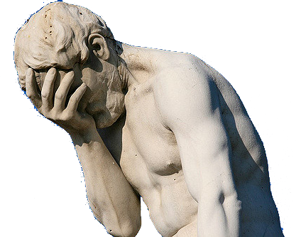
The Caesar shift cipher has a fundamental flaw …..
… we only need to know one letter to decide which Caesar shift cipher has been used.

Slide 13
The cipher has only 26 different keys, which makes it easy to break by frequency analysis (the smart way) or by brute force. If we want to beat the hackers then we need some stronger ciphers with more keys, but that is another lesson. Before that we should probably finish analysing this one.

Slide 14
ACMBW VQCAB PMJQW OZIXP MZWNB PMKIM AIZAL MAKZQ JMARC TQCAK IMAIZ ACAMW NIKQX PMZQV PQATM BBMZA BWBPM WZIBW ZKQKM ZWEQB PEPWU PMEIA XTIVV QVOIV LXTWB BQVOQ VBPML GQVOL IGAWN BPMZW UIVZM XCJTQ KQNPM KIMAI ZPILI VGBPQ VOKWV NQLMV BQITB WAIGP MEZWB MQBQV KQXPM ZBPIB QAJGA WKPIV OQVOB PMWZL MZWNB PMTMB BMZAW NBPMI TXPIJ MBBPI BVWBI EWZLK WCTLJ MUILM WCBQN IVGWV MEQAP MABWL MKQXP MZBPM AMIVL OMBIB BPMQZ UMIVQ VOPMU CABAC JABQB CBMBP MNWCZ BPTMB BMZWN BPMIT XPIJM BVIUM TGLNW ZIIVL AWEQB PBPMW BPMZA QVWBP MZEWZ LAKIM AIZCA MLITM BBMZJ GTMBB MZBZI VATIB QWVBW MVKZG XBPQA UMAAI OMA
A | B | C | D | E | F | G | H | I | J | K | L | M
35 | 57 | 13 |  | 8 |  | 9 |  | 40 | 9 | 15 | 16 | 62
N | O | P | Q | R | S | T | U | V | W | X | Y | Z
11 | 10 | 37 | 33 | 1 |  | 15 | 7 | 29 | 34 | 10 |  | 32
Notes:
Hunting for three letter patterns is hard it is much easier to count the frequency of single letters. In English the letter E is usually the most common. In this cipher text we see that M is the most common letter, so we guess that a shift by 8 has been used. We didn’t need to spot the three letter pattern BPM to do this.

